Slide 2
Erikshjälpen Second Hand
Erikshjälpen is a child rights organisation with a non-profit second-hand business
51 second hand stores and e-commerce, all based on three missions:
Environmental sustainability
Social sustainability
Economic sustainability – financial surplus
All sales are based on donations from private individuals and companies and contribute to our three missions: - a better climate - new beginnings for people outside the labour market - dreams and strengthened rights for children
För barnen. Och världen de drömmer om.
Om Erikshjälpen - Erikshjälpen (erikshjalpen.se)

Slide 3
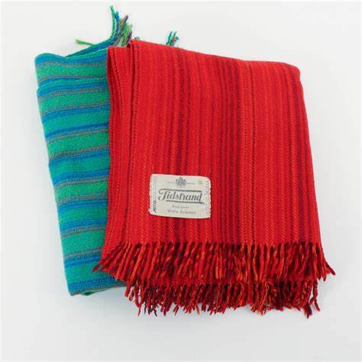
Second hand sales from a sustainable and ethical perspective
Beinga a child rights organisation obligates us – we must be credible in our work towards a better world for children
More stringent guidelines on assortment, based on:
Our values
Child safety
Sustainability
Laws and regulations
Guidelinjes include the list of CITES species, counterfeits, safety products, weapon-like objects, products with harmful chemical content and cosmetics.

Slide 4
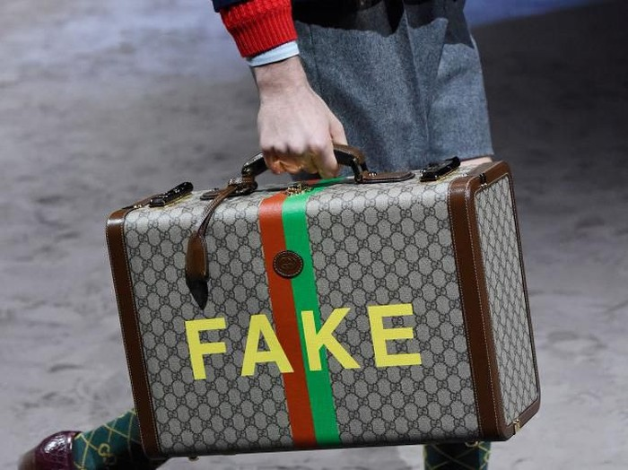
Our efforts against counterfeits
Counterfeits are both an ethical and sustainable issue -selling counterfeits is a violation of the law, and they are often produced under unsustainable circumstances like slave- or child labour. By putting a product like this on the shelf we would indirectly approve this kind of production.
In 2022 we sold 11,5 million products to reuse in Sweden, and sorted many more. To avoid counterfeits we:
Identify common counterfeited products
Highlight key differences between fake and genuine items
When unsure, assume guilt rather than innocence
Acknowledge the absence of 100% reliability due to our staffing situation

Slide 5
www.erikshjalpen.se
Erikshjälpen Second Hand Sustainablity report 2022
Read more about our work

Slide 6
Thank you!
For the children. And the world they dream of.

